Slide 1
Myers Briggs
Dashboard
Chris Guilcapi, Eric Wyluda, Jose Monagas, Katiusca Quijada

Slide 2
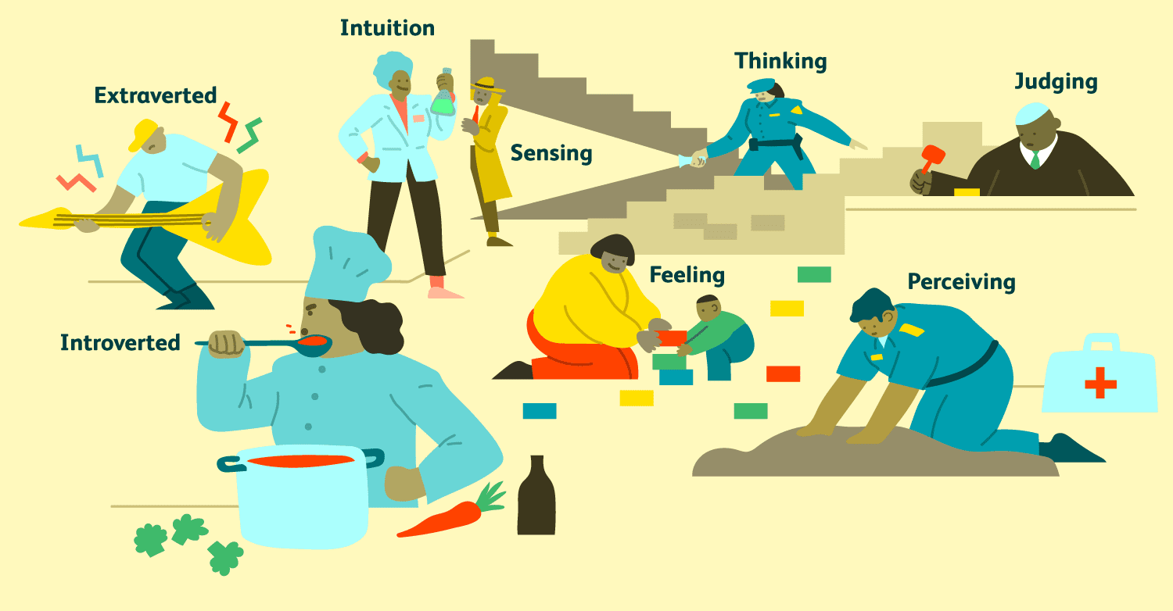
Idea
We want to showcase to users of the dashboard a machine learning model based on Myers Briggs Personality type.
Use of Tableau Public to easily share the dashboard with others.

Slide 3
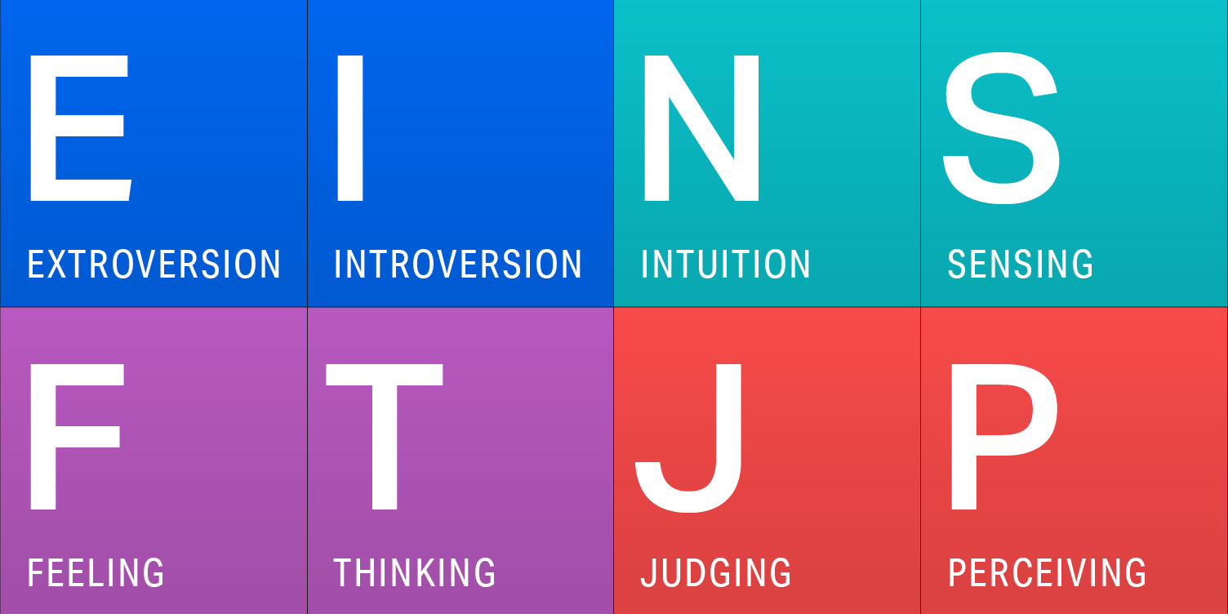
Intro
Introduce the viewer to Myers Briggs and have them either take the test or indicate which they are on the dashboard for interaction.

Slide 4
ML Results
Explain the results seen from the various ML models run and which is best for the given data.

Slide 5
Future Uses
Explain how the ML model and data setup could be used for to capture other data points such as celebrities.

